Slide 1
Rutvik Savaliya
B.E from Ahmedabad institute of technology
Project name : Flower Detection
AI Professional Engineer certified by IBM
Former Intern at iNeuron intelligence pvt ltd.
Github link::Rutvik552k (Rutvik Savaliya) (github.com)
Freelancer at rutviksavaliya | Profile | Fiverr

Slide 2
Flower Detection App
Problem Statement:
Nowadays, It is difficult to identify the name of the flowers especially in india which vast country of flowers.
People don’t have enough knowledge of flowers .
Google have the feature where you just have to click picture of flower and it will give you the all details of flowers but there are False Positive case available
Objective:
Aware people about flowers and plants because most of the plants and flowers are useful for medical treatment and people do not aware about it

Slide 3
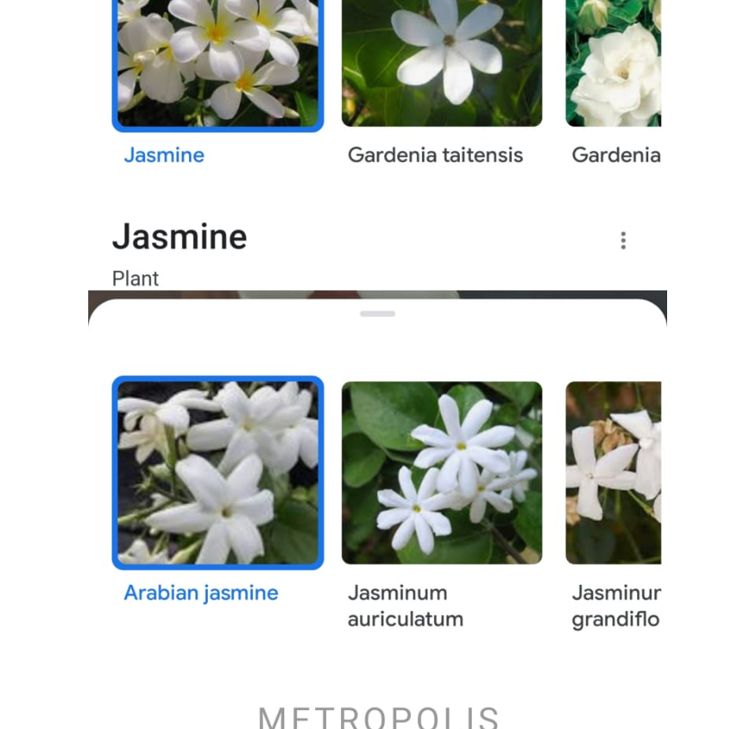
Google False Positive case
Picture of a one flower that has been differently identify by the google.

Slide 4
Solution of this problem upto some extend
Database
Data warehouse
Data cleaning
Data Tag
Data resize
Model building
Weight updation
Access by user
Model Deploy
Check accuracy

Slide 5
Limitation of this project
This app only identify those flower on which this app has been trained
Currently, my app has a ability to identify 5 type of flowers but I continues try to improve this model
Future of this project
I will try to cover all the plants and flower that have been grew in last 100 years

